Slide 1

Today’s Our Topic Is PHYSICAL QUANTITIES
BATCH => 1704A
PARTICIPants => muzammil and aqsa
Faculty => ms.wajiha

Slide 2
“DEFINITION OF PHSICAL QUATITY”
A physical quantity is a quantity in physics that can be measured. Or a physical quantity is a physical property that can be quantified. Examples of physical quantities are mass, amount of substance, length, time, temperature, electric current.

Slide 3
SOME QUANTITIES
NAMES
UNITS
1.LENGTH
2.MASS
3.TIME
4.ELECTRIC CURRENT
5.TEMPRATURE
METER
KILOGRAM
SECOND
AMPERE
KELVIN

Slide 4

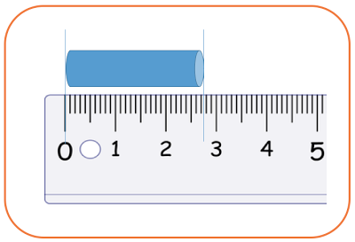
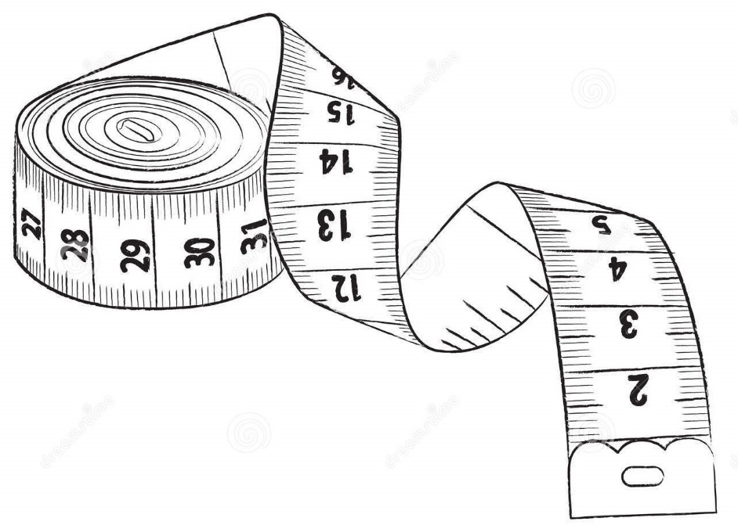
WHAT IS LENGTH
Length is defined as the straight-line distance
between two points along an object.
The SI unit of length is the meter,

Slide 5


WHAT IS MASS
In physics, mass is a property of a physical body. It is the measure of an object's resistance to acceleration (a change in its state of motion) when a net force is applied. It also determines the strength of its mutual gravitational attraction to other bodies. The basic SI unit of mass is the kilogram (kg).

Slide 6



WHAT IS TIME
Time in physics is defined by its measurement: time is what a clock reads. In classical, non-relativistic physics it is a scalar quantity and, like length, mass, and charge, is usually described as a fundamental quantity.

Slide 7

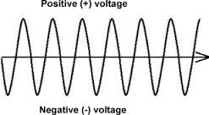
WHAT IS CURRENT
Electric current is defined as the rate at which charge flows through a surface (the cross section of a wire, for example).It’s SI unit is ampere .

Slide 8

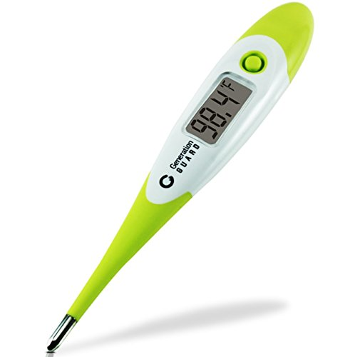
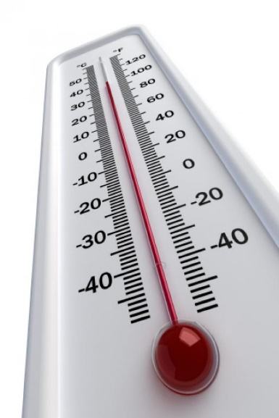
WHAT IS TEMPERATURE
The degree of hotness or coldness of a body or environment is called temperature. A measure of the average kinetic energy of the particles in a sample of matter, expressed in terms of units or degrees designated on a standard scale. It’s SI unit is KELVIN.

